Slide 1
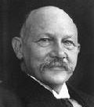
SUPERCONDUCTING MATERIALS
Superconductivity - The phenomenon of losing resistivity when sufficiently cooled to a very low temperature (below a certain critical temperature).
H. Kammerlingh Onnes – 1911 – Pure Mercury
0.15
0.10
0.0
Resistance (Ω)
T_{c}
4.0 4.1 4.2 4.3 4.4
Temperature (K)

Slide 2
Transition Temperature or Critical Temperature (T_{C})
Temperature at which a normal conductor loses its resistivity and becomes a superconductor.
Definite for a material
Superconducting transition reversible
Very good electrical conductors not superconductors eg. Cu, Ag, Au
Types
Low T_{C} superconductors
High T_{C} superconductors

Slide 3
Occurrence of Superconductivity
Superconducting Elements | T_{C} (K)
Sn (Tin) | 3.72
Hg (Mercury) | 4.15
Pb (Lead) | 7.19
Superconducting Compounds
NbTi (Niobium Titanium) | 10
Nb₃Sn (Niobium Tin) | 18.1

Slide 4
Temperature Dependence of Resistance
Electrical Resistivity
ρ=ρ_{o} + ρ(T)
Impurities
Phonons
High Temperature
Low Temperature
Impure Metals
ρ = ρ_{o} + ρ(T)
Pure Metals
ρ = ρ(T)
Impure Metals
ρ = ρ_{o}
Pure Metals
ρ = 0
Superconductor

Slide 5
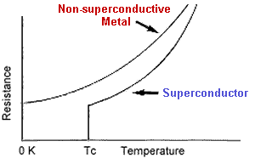
Properties of Superconductors
Electrical Resistance
Zero Electrical Resistance
Defining Property
Critical Temperature
Quickest test
10⁻⁵Ωcm

Slide 6
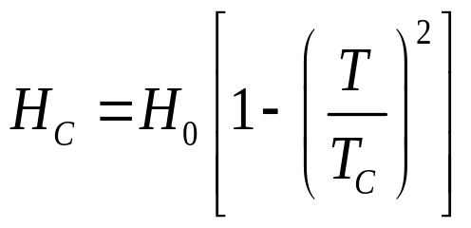
Effect of Magnetic Field
Critical magnetic field (H_{C}) – Minimum magnetic field required to destroy the superconducting property at any temperature
H₀ – Critical field at 0K
T - Temperature below T_{C}
T_{C} - Transition Temperature
Element | H_{C} at 0K (mT)
Nb | 198
Pb | 80.3
Sn | 30.9
H₀
H_{C}
Normal
Superconducting
T (K) T_{C}

Slide 7
Effect of Electric Current
Large electric current – induces magnetic field – destroys superconductivity
Induced Critical Current i_{C} = 2πrH_{C}
Persistent Current
Steady current which flows through a superconducting ring without any decrease in strength even after the removal of the field
Diamagnetic property
i

Slide 8
Magnetic Flux Quantisation
Magnetic flux enclosed in a superconducting ring = integral multiples of fluxon
Φ = nh/2e = n Φ₀ (Φ₀ = 2x10⁻¹⁵Wb)
Effect of Pressure
Pressure ↑, T_{C} ↑
High T_{C} superconductors – High pressure
Thermal Properties
Entropy & Specific heat ↓ at T_{C}
Disappearance of thermo electric effect at T_{C}
Thermal conductivity ↓ at T_{C} – Type I superconductors

Slide 9
Stress
Stress ↑, dimension ↑, T_{C} ↑, H_{C} affected
Frequency
Frequency ↑, Zero resistance – modified, T_{C} not affected
Impurities
Magnetic properties affected
Size
Size < 10⁻⁴cm – superconducting state modified
General Properties
No change in crystal structure
No change in elastic & photo-electric properties
No change in volume at T_{C} in the absence of magnetic field

Slide 10
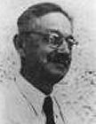

MEISSNER EFFECT
When the superconducting material is placed in a magnetic field under the condition when T≤T_{C} and H ≤ H_{C}, the flux lines are excluded from the material.
Material exhibits perfect diamagnetism or flux exclusion.
Deciding property
χ = I/H = -1
Reversible (flux lines penetrate when T ↑ from T_{C})
Conditions for a material to be a superconductor
  Resistivity ρ = 0
  Magnetic Induction B = 0 when in an uniform magnetic field
Simultaneous existence of conditions

Slide 11
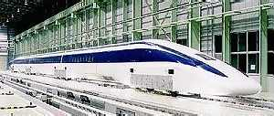
Applications of Meissner Effect
Standard test – proof for a superconductor
Repulsion of external magnets - levitation
Magnet
Superconductor
Yamanashi MLX01 MagLev train

Slide 12
Isotope Effect
Maxwell
T_{C} = Constant / M^{α}
T_{C} M^{α} = Constant (α – Isotope Effect coefficient)
α = 0.15 – 0.5
α = 0 (No isotope effect)
T_{C}√M = constant

Slide 13
Types of Superconductors
Type I
Sudden loss of magnetisation
Exhibit Meissner Effect
One H_{C} = 0.1 tesla
No mixed state
Soft superconductor
Eg.s – Pb, Sn, Hg
Type II
Gradual loss of magnetisation
Does not exhibit complete Meissner Effect
Two H_{C}s – H_{C1} & H_{C2} (≈30 tesla)
Mixed state present
Hard superconductor
Eg.s – Nb-Sn, Nb-Ti
-M
Superconducting
Superconducting
-M
Mixed
Normal
Normal
H_{C}
H
H_{C2}
H_{C1}
H_{C}
H

Slide 14
High Temperature Superconductors
Characteristics
High T_{C}
1-2-3 Compound
Perovskite crystal structure
Direction dependent
Reactive, brittle
Oxides of Cu + other elements

Slide 15
Applications
Large distance power transmission (ρ = 0)
Switching device (easy destruction of superconductivity)
Sensitive electrical equipment (small V variation ➔ large constant current)
Memory / Storage element (persistent current)
Highly efficient small sized electrical generator and transformer

Slide 16
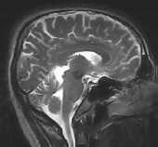
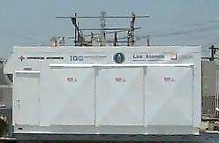
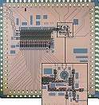
Medical Applications
NMR – Nuclear Magnetic Resonance – Scanning
Brain wave activity – brain tumour, defective cells
Separate damaged cells and healthy cells
Superconducting solenoids – magneto hydrodynamic power generation – plasma maintenance

Slide 17
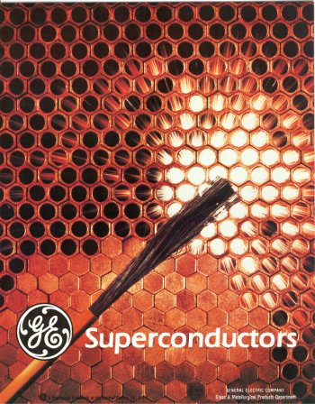
SUPERCONDUCTORS
Superconductivity is a phenomenon in certain materials at extremely low temperatures ,characterized by exactly zero electrical resistance and exclusion of the interior magnetic field (i.e. the Meissner effect)
This phenomenon is nothing but losing the resistivity absolutely when cooled to sufficient low temperatures

Slide 18
WHY WAS IT FORMED ?
Before the discovery of the superconductors it was thought that the electrical resistance of a conductor becomes zero only at absolute zero
But it was found that in some materials electrical resistance becomes zero when cooled to very low temperatures
These materials are nothing but the SUPER CONDUTORS.

Slide 19
WHO FOUND IT?
Superconductivity was discovered in 1911 by Heike Kammerlingh Onnes , who studied the resistance of solid mercury at cryogenic temperatures using the recently discovered liquid helium as ‘refrigerant’.
At the temperature of 4.2 K , he observed that the resistance abruptly disappears.
For this discovery he got the NOBEL PRIZE in PHYSICS in 1913.
In 1913 lead was found to super conduct at 7K.
In 1941 niobium nitride was found to super conduct at 16K

Slide 20
APPLICATIONSOF
SUPER CONDUCTORS

Slide 21
1. Engineering
Transmission of power
Switching devices
Sensitive electrical instruments
Memory (or) storage element in computers.
Manufacture of electrical generators and transformers

Slide 22
2. Medical
Nuclear Magnetic Resonance (NMR)
Diagnosis of brain tumor
Magneto – hydrodynamic power generation

Slide 23
JOSEPHSON DEVICES by Brian Josephson

Slide 24
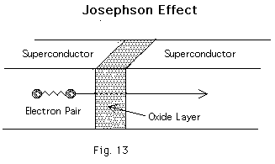
Principle: persistent current in d.c. voltage
Explanation:
Consists of thin layer of insulating material placed between two superconducting materials.
Insulator acts as a barrier to the flow of electrons.
When voltage applied current flowing between super conductors by tunneling effect.
Quantum tunnelling occurs when a particle moves through a space in a manner forbidden by classical physics, due to the potential barrier involved

Slide 25
Components of current
In relation to the BCS theory (Bardeen Cooper Schrieffer) mentioned earlier, pairs of electrons move through this barrier continuing the superconducting current. This is known as the dc current.
Current component persists only till the external voltage application. This is ac current.

Slide 26
Uses of Josephson devices
Magnetic Sensors
Gradiometers
Oscilloscopes
Decoders
Analogue to Digital converters
Oscillators
Microwave amplifiers
Sensors for biomedical, scientific and defence purposes
Digital circuit development for Integrated circuits
Microprocessors
Random Access Memories (RAMs)

Slide 27
SQUIDS
(Super conducting Quantum Interference Devices)

Slide 28
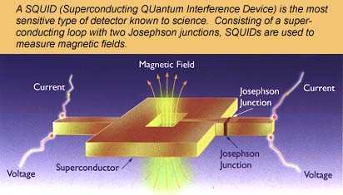

Slide 29
Discovery: The DC SQUID was invented in 1964 by Robert Jaklevic, John Lambe, Arnold Silver, and James Mercereau of Ford Research Labs
Principle :
Small change in magnetic field, produces variation in the flux quantum.
Construction:
The superconducting quantum interference device (SQUID) consists of two superconductors separated by thin insulating layers to form two parallel Josephson junctions.

Slide 30
Types
Two main types of SQUID: 1) RF SQUIDs have only one Josephson junction
2)DC SQUIDs have two or more junctions.
Thereby,
more difficult and expensive to produce.
much more sensitive.

Slide 31
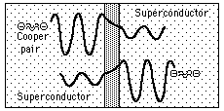
Josephson junctions
A type of electronic circuit capable of switching at very high speeds when operated at temperatures approaching absolute zero.
Named for the British physicist who designed it,
a Josephson junction exploits the phenomenon of superconductivity.

Slide 32
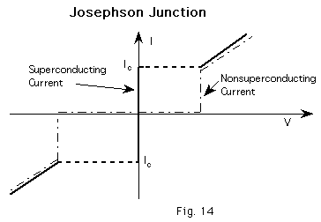
Construction
A Josephson junction is made up of two superconductors, separated by a nonsuperconducting layer so thin that electrons can cross through the insulating barrier.
The flow of current between the superconductors in the absence of an applied voltage is called a Josephson current,
the movement of electrons across the barrier is known as Josephson tunneling.
Two or more junctions joined by superconducting paths form what is called a Josephson interferometer.

Slide 33
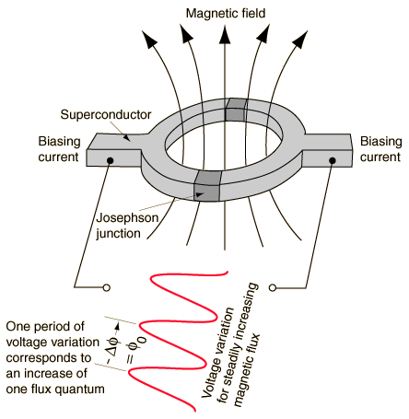
Construction :
Consists of superconducting ring having magnetic fields of quantum values(1,2,3..)
Placed in between the two josephson junctions

Slide 34
Explanation :
When the magnetic field is applied perpendicular to the ring current is induced at the two junctions
Induced current flows around the ring thereby magnetic flux in the ring has quantum value of field applied
Therefore used to detect the variation of very minute magnetic signals

Slide 35
Fabrication
Lead or pure niobium The lead is usually in the form of an alloy with 10% gold or indium, as pure lead is unstable when its temperature is repeatedly changed.
The base electrode of the SQUID is made of a very thin niobium layer
The tunnel barrier is oxidized onto this niobium surface.
The top electrode is a layer of lead alloy deposited on top of the other two, forming a sandwich arrangement.
To achieve the necessary superconducting characteristics, the entire device is then cooled to within a few degrees of absolute zero with liquid helium

Slide 36
Uses
Storage device for magnetic flux
Study of earthquakes
Removing paramagnetic impurities
Detection of magnetic signals from brain, heart etc.

Slide 37
Cryotron
The cryotron is a switch that operates using superconductivity. The cryotron works on the principle that magnetic fields destroy superconductivity. The cryotron is a piece of tantalum wrapped with a coil of niobium placed in a liquid helium bath. When the current flows through the tantalum wire it is superconducting, but when a current flows through the niobium a magnetic field is produced. This destroys the superconductivity which makes the current slow down or stop.

Slide 38
Magnetic Levitated Train
Principle: Electro-magnetic induction
Introduction:
Magnetic levitation transport, or maglev, is a form of transportation that suspends, guides and propels vehicles via electromagnetic force. This method can be faster than wheeled mass transit systems, potentially reaching velocities comparable to turboprop and jet aircraft (500 to 580 km/h).

Slide 39
Why superconductor ?
Superconductors may be considered perfect diamagnets (μr = 0), completely expelling magnetic fields due to the Meissner effect. The levitation of the magnet is stabilized due to flux pinning within the superconductor. This principle is exploited by EDS (electrodynamicsuspension) magnetic levitation trains.
In trains where the weight of the large electromagnet is a major design issue (a very strong magnetic field is required to levitate a massive train) superconductors are used for the electromagnet, since they can produce a stronger magnetic field for the same weight.

Slide 40
How to use a Super conductor
Electrodynamic suspension
In Electrodynamic suspension (EDS), both the rail and the train exert a magnetic field, and the train is levitated by the repulsive force between these magnetic fields. The magnetic field in the train is produced by either electromagnets or by an array of permanent magnets The repulsive force in the track is created by an induced magnetic field in wires or other conducting strips in the track.
At slow speeds, the current induced in these coils and the resultant magnetic flux is not large enough to support the weight of the train. For this reason the train must have wheels or some other form of landing gear to support the train until it reaches a speed that can sustain levitation.
Propulsion coils on the guideway are used to exert a force on the magnets in the train and make the train move forwards. The propulsion coils that exert a force on the train are effectively a linear motor: An alternating current flowing through the coils generates a continuously varying magnetic field that moves forward along the track. The frequency of the alternating current is synchronized to match the speed of the train. The offset between the field exerted by magnets on the train and the applied field create a force moving the train forward

Slide 41
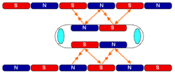

Slide 42
Advantages
No need of initial energy in case of magnets for low speeds
One litre ofLiquid nitrogen costs less than one litre of mineral water
Onboard magnets and large margin between rail and train enable highest recorded train speeds (581 km/h) and heavy load capacity.Successful operations using high temperature superconductors in its onboard magnets, cooled with inexpensive liquid nitrogen
Magnetic fields inside and outside the vehicle are insignificant; proven, commercially available technology that can attain very high speeds (500 km/h); no wheels or secondary propulsion system needed
Free of friction as it is “Levitating”

